Slide 1
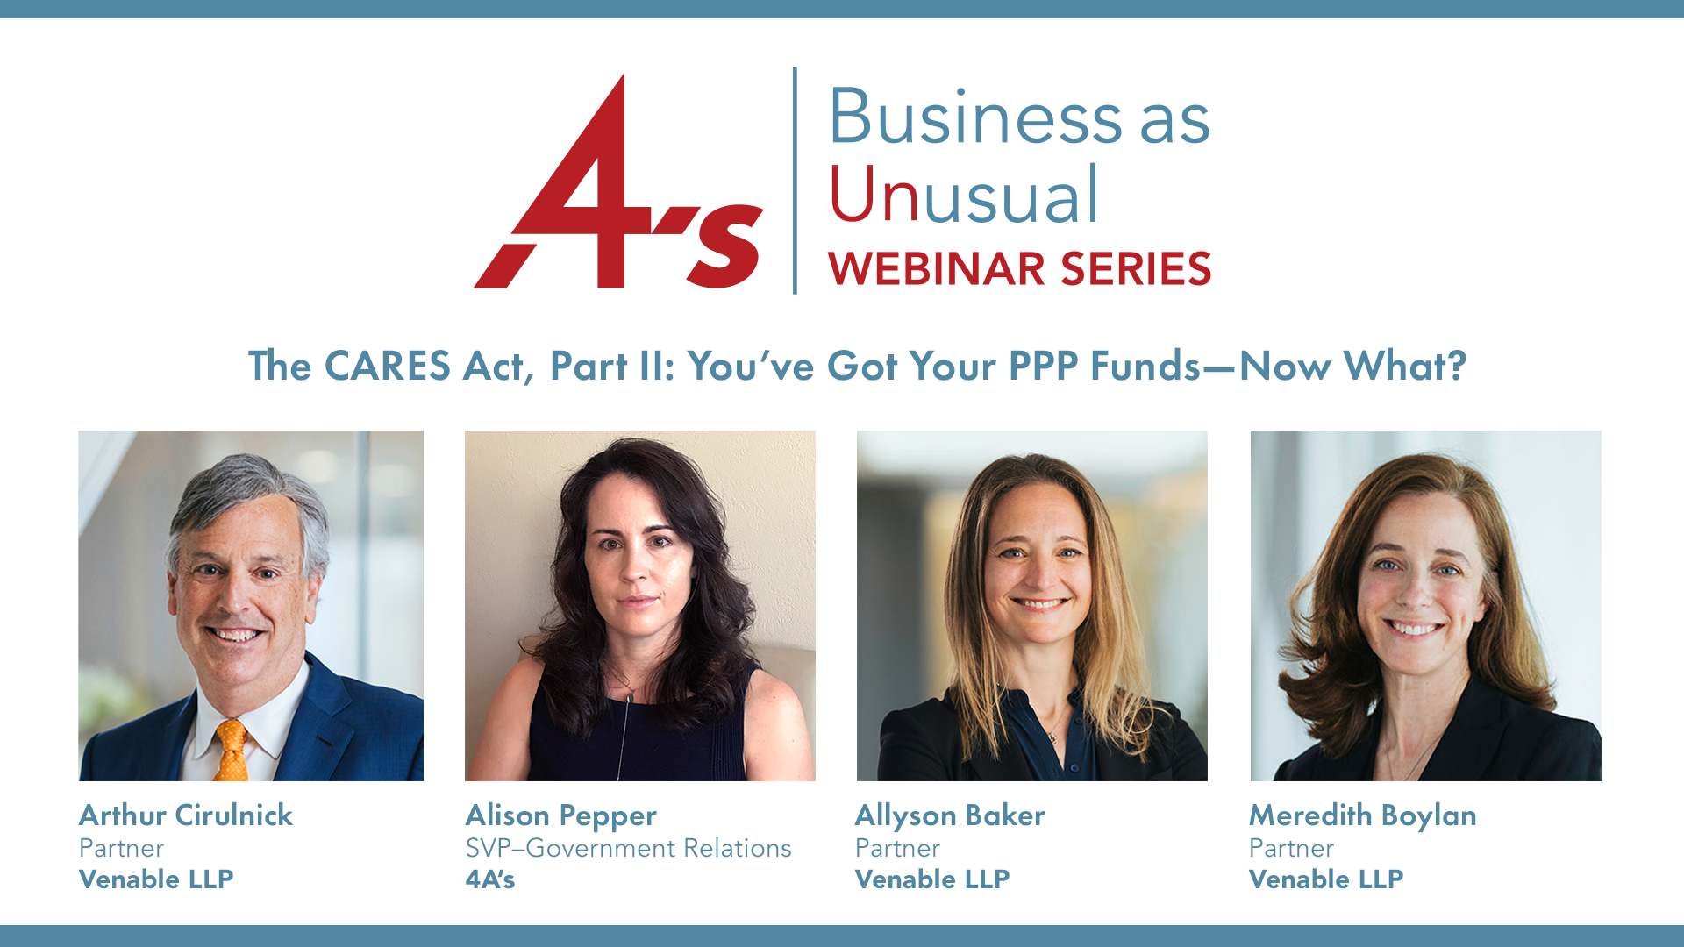

Slide 2
AGENDA
01 | Welcome
02 | Washington, DC Update
03 | PPP Update
04 | Questions
05 | Closing

Slide 3
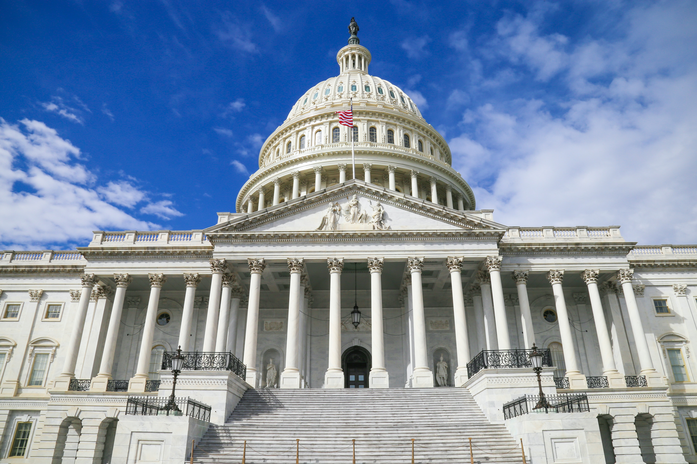
Congress And Coronavirus
1. Coronavirus Preparedness And Response Supplemental Appropriations Act, March 06, Cost: $8.3 Billion.
2. Families First Coronavirus Response Act (FFCRA), March 18, Cost: Between $183 – $350 Billion.
3. The Coronavirus Aid, Relief, And Economic Security Act (CARES), March 27, Cost: Between $2 and $2.2 Trillion.
4. The Paycheck Protection Program And Health Care Enhancement Act, April 23, Cost: $484 Billion.
Total Congressional Spending Thus Far: $2.675 to $3.04 Trillion

Slide 4
PPP: WHAT COMES NEXT?
FORGIVENESS & GOOD FAITH CERTIFICATION
Webinar | April 30, 2020
Allyson B. Baker
Meredith L. Boylan
Partner | +1 202.344.4708 | abaker@Venable.com
Partner | +1 202.344.8062 | mlboylan@Venable.com
Arthur E. Cirulnick
Partner | +1 415.653.3706 | aecirulnick@Venable.com

Slide 5
The Paycheck Protection Program: Background
Title I authorizes $349 billion for small businesses through federally backed loans under a modified Small Business Administration (SBA) 7(a) loan guaranty program
Qualifying businesses apply to SBA-approved lenders for loans up to 2.5 times their average monthly payroll costs (up to $10 million)
  2 year term; 1% interest
Each business can receive the lesser of $10 million or the sum of 2.5 times the average total monthly payroll costs for the prior year
Loan proceeds may be used for qualified payroll costs, rent, utilities, and interest on mortgage and other debt obligations
Loan forgiveness is available only for funds used to pay for payroll costs, rent, utilities, and interest on mortgage for the first 8 weeks after the loan originates
  At least 75% must be used for payroll
All payments (including interest) will be deferred for 6 months
No collateral or personal guarantee is required

Slide 6
Who Qualifies for Relief?
Qualifying businesses include
  Small business concerns as defined by the SBA’s size standards.
  Businesses, 501(c)(3) nonprofit organizations, veterans organizations, and tribal business concerns with up to 500 employees or which meet the applicable employee size standard for the industry as provided by SBA's existing regulations.
  Businesses in the accommodation and food services industries with more than one physical location but no more than 500 employees at each location.
  Eligible independent contractors and sole proprietors.
Certain SBA affiliate rules waived.

Slide 7
How Must Relief Be Used?
Businesses can use funds from the Program loans to cover expenses including:
  Payroll costs, including compensation to employees; payments for vacation, parental, family, medical or sick leave; severance payments; payments required for group health care benefits (including insurance premiums), retirement benefits, and state and local employment taxes
  Interest payments on any mortgage obligations or other debt obligations incurred before February 15, 2020 (but not any payments or prepayments of principal)
  Rent and utilities
The money cannot be used for:
  compensation of individual employees, independent contractors, or sole proprietors in excess of an annualized salary of $100,000;
  compensation of employees with principal place of residence outside the U.S.; or
  leave wages already covered by the Families First Coronavirus Response Act.

Slide 8
Loan Forgiveness
Borrowers may apply for loan forgiveness for certain eligible expenses:
  Payroll costs
  Rent payments
  Utility payments
  Interest on mortgage payments
Per recent Treasury/SBA guidance, 75% of the amount forgiven must be used to cover payroll costs
Borrowers must apply for loan forgiveness to their lenders by submitting required documentation and will receive a decision within 60 days.

Slide 9
Reductions to Loan Forgiveness
Reductions in FTE: Reduction in number of full-time equivalent employees (FTEs) in 8-week period after origination of loan.
  Period for calculating FTEs is average number from either (A) February 15, 2019 to June 30, 2019 or (B) January 1, 2020 to February 29, 2020.
  Number of FTEs determined by calculating average number of FTEs for each pay period falling within a month.
Reductions in Payroll: Reduction in pay of any employee making less than $100,000 by more than 25% - compared to last complete calendar quarter
  No limit to amount of reduction in pay of employees who make over $100,000.

Slide 10
Benefits of Rehiring
No penalty for lay-offs from February 15, 2020 to April 26, 2020 if employees are re-hired by June 30, 2020.
  Employee count is based on number of FTEs as of June 30, 2020 being equal to number of FTEs as of February 15, 2020.
  Example: Company A has 100 employees as of February 15, 2020, but it laid off 50 employees on April 1, 2020. If Company A has at least 100 employees as of June 30, 2020, there will be no penalty regarding the amount of loan forgiveness.

Slide 11
Repairing Reductions in Payroll
No penalty for salary reductions from February 15, 2020 to April 26, 2020 if salaries are restored to original amount by June 30, 2020.
  Example: On February 15, 2020, Company A decreased the salaries of employees making $75,000 to $50,000. If Company A increases the salaries of those employees back to $75,000 by June 30, 2020, there will be no penalty regarding the amount of loan forgiveness.
Keep in mind that this possible reduction in loan forgiveness applies only to employees who make less than $100,000 per year.

Slide 12
Good Faith Certification
Under the CARES Act, borrowers are required to “make a good faith certification . . . that the uncertainty of current economic conditions makes necessary the loan request to support the ongoing operations of the eligible recipient.”
After first round of funding, media stories about how publicly-traded companies had taken PPP loans
SBA and Treasury issue post-hoc informal guidance and formal guidance through Interim Final Rule
Guidance designed to respond to media stories and political concerns about the nature, size, and need of PPP Loan recipients

Slide 13
Good Faith Certification: FAQ and Rule
SBA and Treasury issued additional guidance in the form of FAQ No. 31.
  Adds a new standard for receiving a loan, namely that borrowers must “assess their economic need for a PPP loan.”
  Borrowers must “tak[e] into account their current business activity and their ability to access other sources of liquidity sufficient to support their ongoing operations in a manner that is not significantly detrimental to the business.”
  For example, publicly-traded companies with “substantial market value and access to capital markets” and notes that “such a company should be prepared to demonstrate to the SBA, upon request, the basis for its certification.”
SBA Rule on April 24:
  Provides safe harbor for recipients of loan in light of Certification Guidance
  Can return loan by May 7 and deemed to still be in good faith

Slide 14
Good Faith Certification: Best Practices
Document need for the loan
  Forecasts and models
  Demonstration of need in the event of declining revenue
Addressing economic uncertainty
Understand and explain relative access to other sources of liquidity
Explain detriment to ongoing business operations

Slide 15
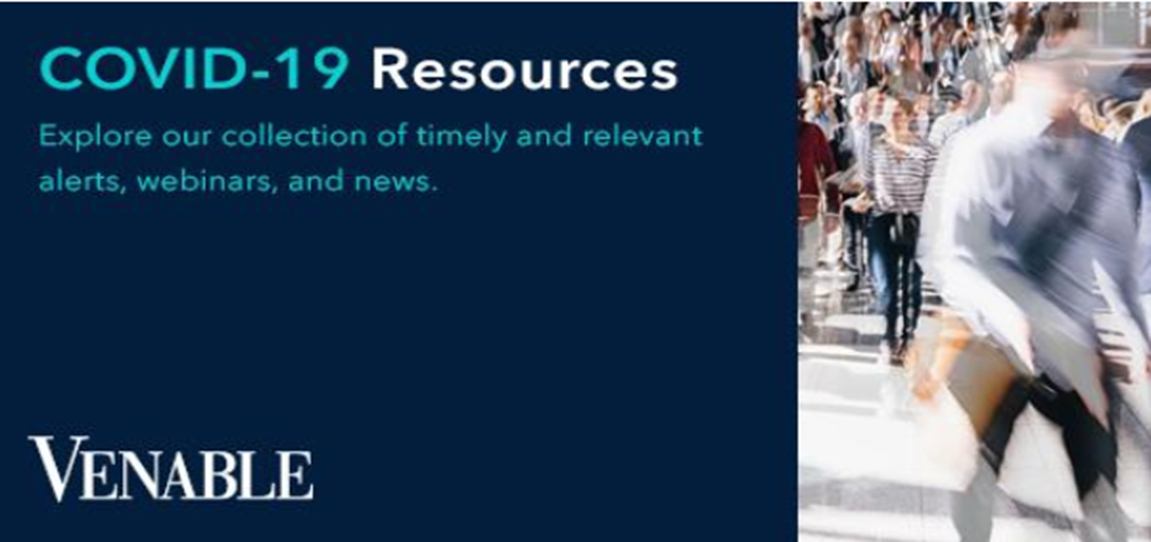
www.Venable.com/COVIDCFS
www.Venable.com/covid-19

Slide 16
Question #1
Should I keep my PPP funds in a separate bank account for expense tracking purposes?

Slide 17
Question #2
Does forgiveness include interest on prior debt agreements other than mortgages?

Slide 18
Question #3
My agency has several employees compensated over 100K. How do I calculate their wages for forgiveness?

Slide 19
Question #4
What if our PPP funding occurred on a day after our current payroll cycle, and so in the next eight weeks we only have 3 semi-monthly payrolls. Can we move-up our fourth payroll by a couple of days to get into the eight-week window? Does it matter?

Slide 20
Question #5
If I spend more than 25% of my PPP funds on overhead, will that reduce my forgiveness, even if my overhead expenses went-up during the eight-week period?

Slide 21
Question #6
My landlord reduced our rent by 50% starting one week after I received the PPP funds, but we have to pay back the difference at the end of three months. Can I count those future costs against the eight-week forgiveness period, as the expense was “incurred” during the eight-week period?

Slide 22
Question #7
I’ve kept the number of employees on my payroll the same, but I’ve lowered some salaries and raised others. While my total payroll is the same, the allocation of wages is not. Will this impact my forgiveness?

Slide 23
Question #8
I’ve had some employees come to me to ask me to lay them off, and then rehire them later in the year, as they’ve calculated that they can receive more money with the expanded UI compensation. Will this still be counted against my forgiveness?

Slide 24
Question #9
Will any loan forgiveness I receive be taxed as gross income by the IRS? Will it be taxed by the state?

Slide 25
Question #10
My agency had a pre-existing SBA 7(a) loan before the announcement of the PPP loans. Can I refinance that loan into a PPP loan?

Slide 26
Question #11
My agency works with a small lender who informed us that they can’t fund us for the full 100% of funds that we’re eligible for – can we get half of our funds from one lender, and half from another?

Slide 27
Question #12
It’s recently come to light that a lot of the money earmarked for the PPP loans has been given to businesses that were not truly “small businesses.” Is there going to be any recourse against the lenders for not vetting that this money was going to the true small businesses?

Slide 28
Other Questions

Slide 29
THANK YOU

Slide 30
